Slide 1

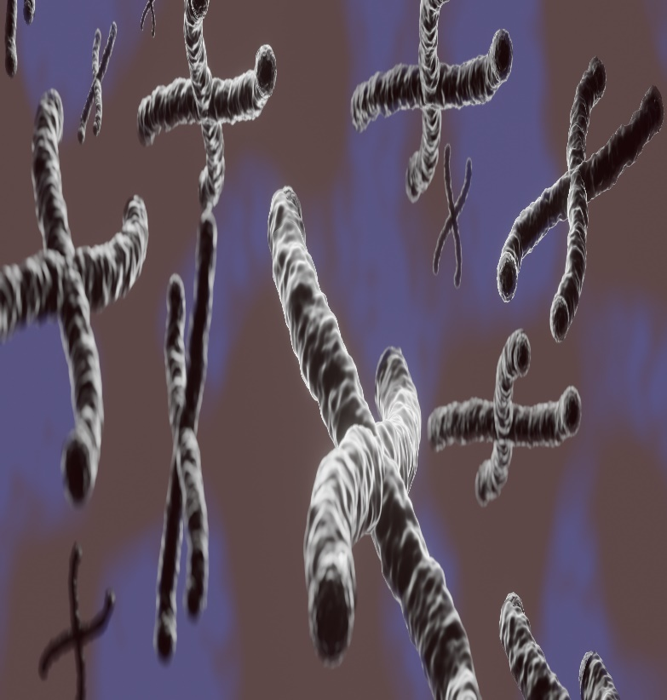
Mutations and Multiple Alleles
Life Science
Chapter 3 - Document 2
Chromosomes in 3D illustration by M. Ouaidat
Grade : Secondary Education – Third Year
Section : Life Sciences - English
Part : I

Slide 2

1
Types of Gene Mutations
2
Consequences of Mutations
3
Genes and Multiple Alleles: Molecular Basis of ABO System
4
Genetic Code
4
5
Third secondary year/part I/ Life Sciences - English

Slide 3
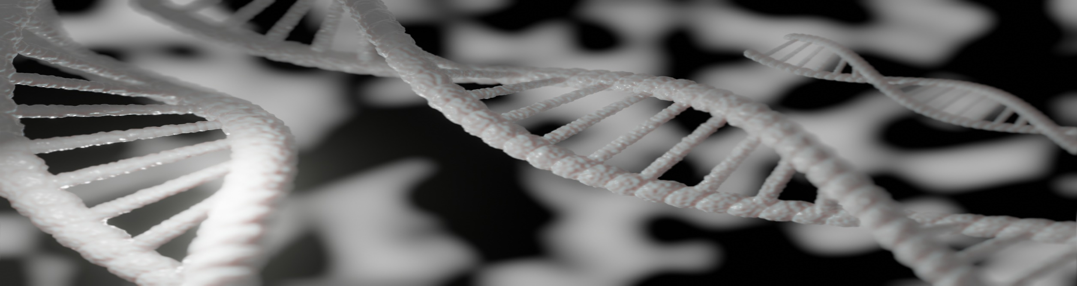
For many years, geneticists believed that a gene exists only under 2 allelic forms. Nowadays, we know that a gene can have many different allelic forms which result from multiple mutations.
Doc1: DNA molecule in 3D illustration by M. Ouaidat
What are the different types of gene mutations?
What is the relationship between mutations and multiple alleles?
Third secondary year/part I/ Life Sciences - English

Slide 4
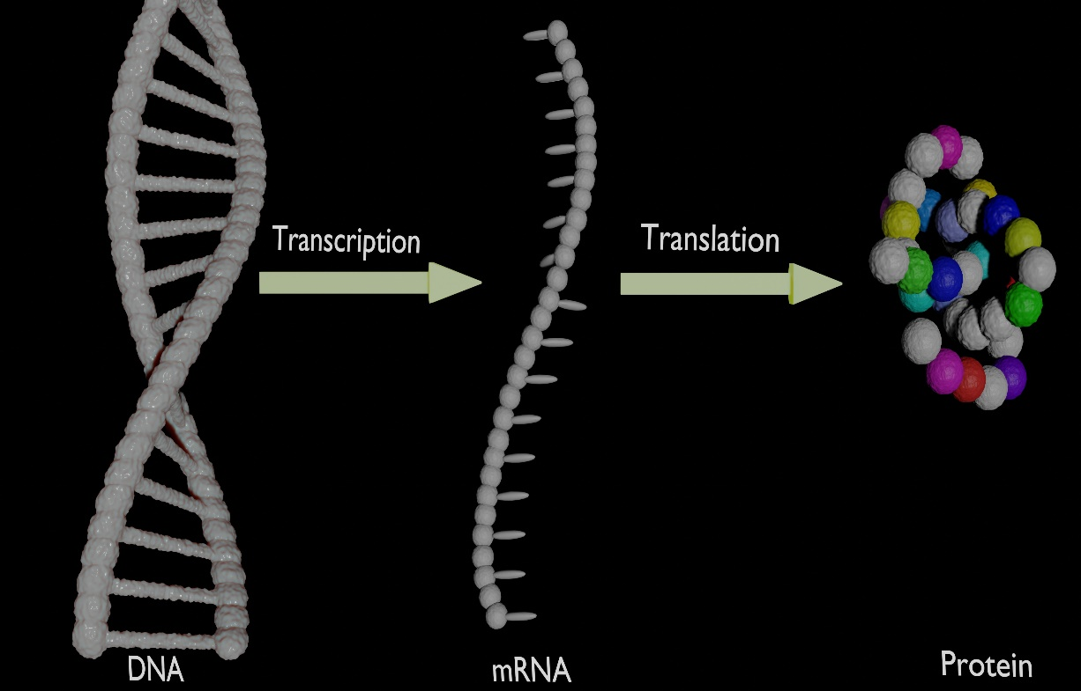
Document 2 shows the two steps of protein synthesis: the transcription which occurs in the nucleus and the translation which occurs in the cytoplasm.
Doc2: Steps of protein synthesis in 3D illustration by M. Ouaidat
Transcription Process
https://www.youtube.com/watch?v=a8m66n9oSdk&list=PLvuj2S3rwuvt6AK7feqIW8zgj2n8r8l64
Translation Process
https://www.youtube.com/watch?v=s57DwCQf5tY&list=PLvuj2S3rwuvt6AK7feqIW8zgj2n8r8l64&index=3
Third secondary year/part I/ Life Sciences - English

Slide 5
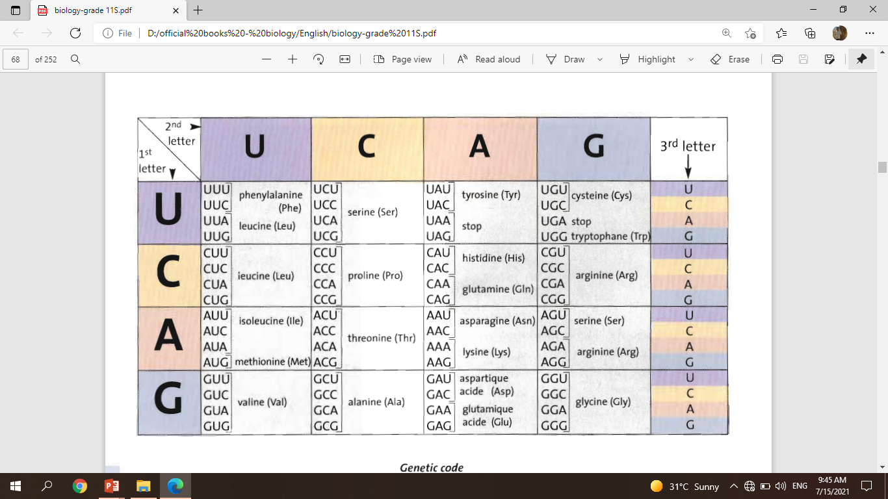
1
2
How to determine the amino acidS sequence?
Two ways can be used to determine the amino acids sequence coded by a gene of the given double-stranded DNA fragment. These are: Non transcribed strand AAT ACG ATG
Transcribed strand TTA TGC TAC.
The non transcribed DNA strand
The transcribed DNA strand
AAT ACG ATG
TTA TGC TAC
The mRNA sequence
will be
The mRNA sequence
will be
AAU ACG AUG
AAU ACG AUG
Doc3: Genetic code table (by CRDP)
And by using the genetic code table, the mRNA is translated into the following amino acids sequence.
Asn
Thr
Met
Asn
Thr
Met
Third secondary year/part I/ Life Sciences - English

Slide 6
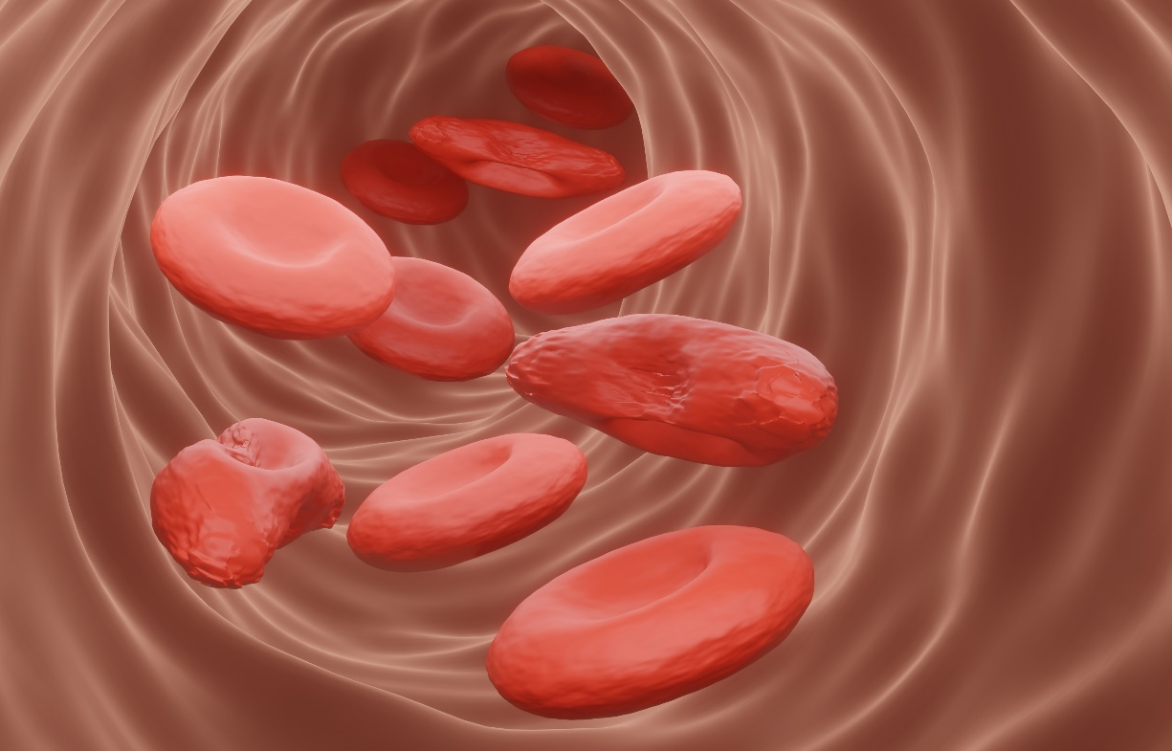
What is a gene mutation?
A gene mutation is a change in the nucleotide sequence of DNA. It is a spontaneous event, but it can be induced experimentally. It can be harmful such as a mutation leading to some disorders like cancer, sickle cell anemia, … or beneficial as in the case of a mutation protecting the people of Limone (Italy) from developing atherosclerosis or a mutation that could occur in bacteria that allows it to survive in the presence of antibiotic drugs.
1- Pick out from the text:
1-1. the definition of gene mutation
A gene mutation is a change in the nucleotide sequence of DNA.
1-2. one example of harmful mutation and another one of beneficial mutation
Harmful: mutation leading to cancer.
Beneficial: mutation protecting from atherosclerosis.
Normal RBC
Sickle RBC
Doc4: Sickle cell anemia in 3D illustration by M. Ouaidat
Third secondary year/part I/ Life Sciences - English

Slide 7
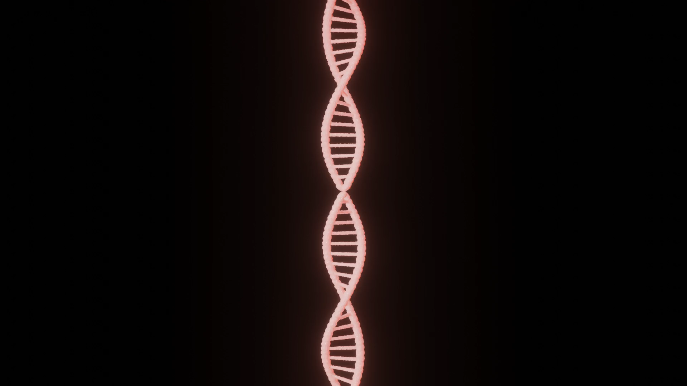
What are the types of gene mutation?
Gene mutation can be substitution when one nucleotide in the DNA sequence is replaced by another one, or deletion when one nucleotide is deleted, or insertion when one nucleotide is inserted. Mutation which affects one nucleotide is said to be “point mutation”, while it is a “stretch mutation” when it affects hundreds or thousands of nucleotides.
2- List the three types of gene mutation.
Substitution mutation.
Deletion mutation.
Insertion mutation.
Doc5: DNA molecule in 3D animation by M. Ouaidat
Third secondary year/part I/ Life Sciences - English

Slide 8
T
Documents 6a and 6b show respectively a part of the non transcribed DNA sequence of a normal gene and that of a mutated gene.
C
C
A
G
A
G
A
C
T
C
C
A
G
A
G
A
C
T
Doc 6a: Part of the non transcribed DNA sequence of a normal gene.
Doc 6b: Part of the non transcribed DNA sequence of a mutant gene.
3- Name the mutation represented in the above document.
Mutation by substitution.
4- Determine, referring to the genetic code table, the amino acids sequence for each of the non transcribed DNA sequence of the normal and mutated genes.
mRNA is identical to the non transcribed DNA strand but T is replaced by U.
mRNA of normal gene mRNA of mutated gene
Amino acids sequence Amino acids sequence
C
C
A
G
A
G
A
C
U
C
C
A
G
U
G
A
C
U
Pro
Glu
Thr
Pro
Val
Thr
Third secondary year/part I/ Life Sciences - English

Slide 9
T
Documents 6a and 6b show respectively a part of the non transcribed DNA sequence of a normal gene and that of a mutated gene.
C
C
A
G
A
G
A
C
T
C
C
A
G
A
G
A
C
T
Doc 6a: Part of the non transcribed DNA sequence of a normal gene.
Doc 6b: Part of the non transcribed DNA sequence of a mutant gene.
5- Compare for a normal gene and a mutant one:
5-1. the two DNA sequences
The two DNA sequences are identical in all their nucleotides except the 5th nucleotide (number 5) where it is A in the normal gene while it is T in the mutant one.
5-2. the two amino acid sequences
The two amino acid sequences are identical except the 2nd amino acid where it is Glu in the protein coded by the normal gene while it is Val in the protein coded by the mutant one.
6- Indicate the possible effect of this mutation.
This mutation modifies the amino acids sequence which affects the three - dimensional structure of the synthesized protein and consequently can modify its function.
Pro
Glu
Thr
Pro
Val
Thr
Third secondary year/part I/ Life Sciences - English

Slide 10
Documents 7a and 7b show respectively a part of the non - transcribed DNA sequence of a normal gene and that of a mutated gene and their corresponding amino acid sequences.
C
C
A
G
A
G
A
C
T
C
C
A
G
A
A
A
C
T
G
Pro
Glu
Thr
Pro
Glu
Thr
Doc 7a: Part of the non transcribed DNA sequence of a normal gene and the corresponding amino acids sequence
Doc 7b: Part of the non transcribed DNA sequence of a mutant gene and the corresponding amino acids sequence
7- Justify why the mutation represented by doc. 7b is said to be “silent mutation”, knowing that silent mutation leads to the synthesis of the same protein.
This mutation changes the DNA sequence, but the corresponding amino acids sequence remains the same which does not affect the three dimensional structure of the protein. Consequently, the same protein is synthesized, so this mutation passes unnoticed. This is why it is said to be "silent mutation".
Third secondary year/part I/ Life Sciences - English

Slide 11
Documents 8a and 8b show respectively a part of the non - transcribed DNA sequence of a normal gene and that of a mutated gene and their corresponding amino acid sequences.
C
C
A
G
A
G
A
C
C
C
A
T
A
G
A
C
T
T
G
Stop
Pro
Glu
Thr
Pro
Doc 8a: Part of the non transcribed DNA sequence of a normal gene and the corresponding amino acids sequence
Doc 8b: Part of the non transcribed DNA sequence of a mutant gene and the corresponding amino acids sequence
8- Justify why the mutation represented by doc. 8b is said to be “nonsense mutation”, knowing that nonsense mutation leads to the synthesis of incomplete polypeptide and consequently a truncated protein.
This mutation affects the codon for the amino acid (Glu) which is changed to a stop codon; this results in a truncated protein (a shorter incomplete amino acids sequence) which modifies the three dimensional structure of the protein that is usually a non-functional protein. For this reason, this mutation is a “nonsense mutation”.
Third secondary year/part I/ Life Sciences - English

Slide 12
Documents 9a and 9b show respectively a part of the non - transcribed DNA sequence of a normal gene and that of a mutated gene and their corresponding amino acid sequences.
T
A
C
A
C
C
A
C
G
A
T
A
C
A
C
C
A
C
G
A
Frame-shift
Tyr
Thr
Thr
Tyr
Pro
Arg
Doc 9a: Part of the non transcribed DNA sequence of a normal gene and the corresponding amino acids sequence
Doc 9b: Part of the non transcribed DNA sequence of a mutant gene and the corresponding amino acids sequence
9- Name the type of the mutation represented in doc.9b.
Deletion mutation.
Third secondary year/part I/ Life Sciences - English

Slide 13
Documents 10a and 10b show respectively a part of the non - transcribed DNA sequence of a normal gene and that of a mutated gene and their corresponding amino acid sequences.
T
A
C
T
A
C
G
C
C
A
C
A
C
G
A
A
C
A
C
G
A
Frame-shift
Tyr
Thr
Thr
Tyr
Asp
His
Doc 10a: Part of the non transcribed DNA sequence of a normal gene and the corresponding amino acids sequence
Doc 10b: Part of the non transcribed DNA sequence of a mutant gene and the corresponding amino acids sequence.
10- What is the type of the mutation represented in doc.10b?
Insertion mutation.
11- Draw out, based on all what precedes, the type of mutations where the amino acids sequence situated after the mutation site changes.
Mutation by deletion or insertion
Third secondary year/part I/ Life Sciences - English

Slide 14
Molecular basis of ABO system
A classical example of multiple alleles in humans is the ABO blood group system. Click the link below to watch the video and answer the following questions.
https://www.youtube.com/watch?v=foUR_i1pxz4
12- Indicate the location of molecules A, B, and O.
They are located on the surface of the red blood cells.
13- Compare the structure of molecules A, B, and O.
All Molecules A, B, and O have the same basic structure called substance H. Molecule A has a supplementary sugar, N-acetylgalactosamine, while molecule B has a supplementary sugar, galactose. However, molecule O has no supplementary sugar.
14- Indicate the role of each of the transferase enzymes.
Transferase A adds the sugar, N-acetylgalactosamine, to the substance H to form antigen A.
Transferase B adds the sugar galactose to the substance H to form antigen B.
Inactivated transferase O does not add any sugar to the substance H.
Third secondary year/part I/ Life Sciences - English

Slide 15
Molecular basis of ABO system
A classical example of multiple alleles in humans is the ABO blood group system. Click the link below to watch the video and answer the following questions.
https://www.youtube.com/watch?v=foUR_i1pxz4
15- Explain what this difference in structure is due to.
Mutations cause diverse alleles of the same gene:
Allele O is due to a deletion of an ancestral gene, which leads to a truncated and non -functional transferase enzyme which does not add any sugar to substance H;
whereas alleles A and B are due to four mutations by substitution which result in transferase enzymes A and B that differ by four amino acids. These mutations modify the function of the transferase enzyme, transferase A coded by the allele A adds the sugar N-acetylgalactosamine to the substance H to form antigen A. On the other hand, transferase B coded by the allele B adds the sugar galactose to the substance H to form antigen B.
16- Draw out, based on all what precedes, the definition of genetic polymorphism and its possible cause.
Genetic polymorphism refers to the simultaneous occurrence, in a population of allelic variations. This is due to a mutation affecting the DNA sequence.
Third secondary year/part I/ Life Sciences - English

Slide 16
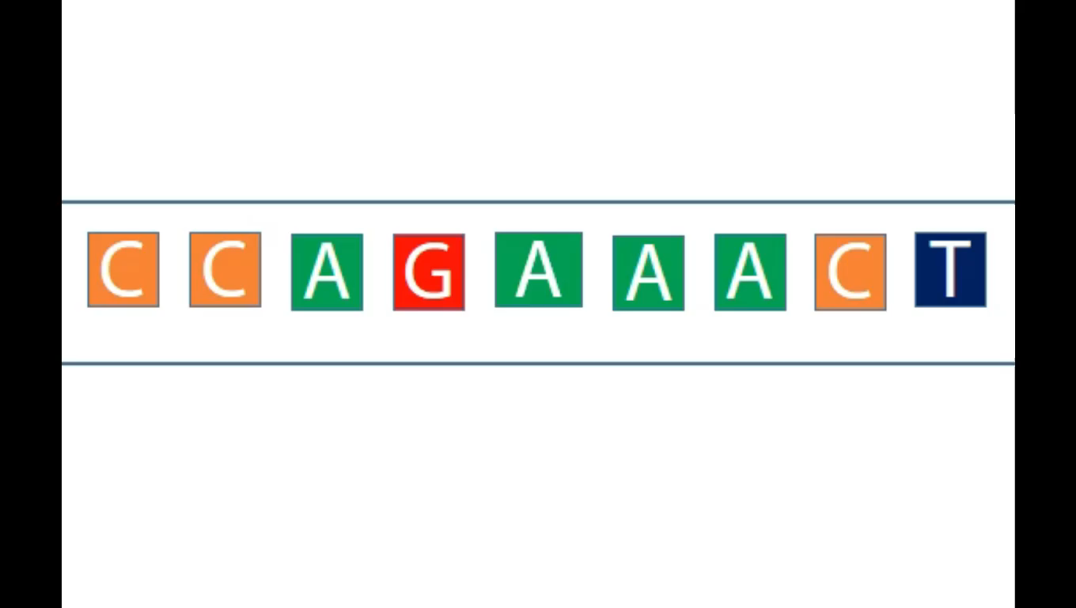


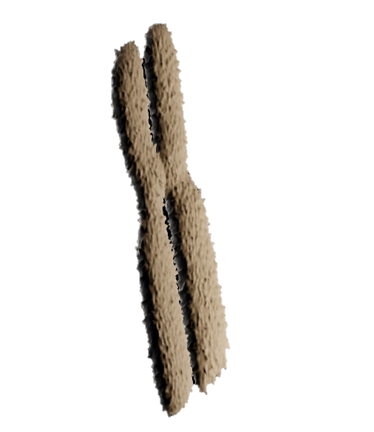
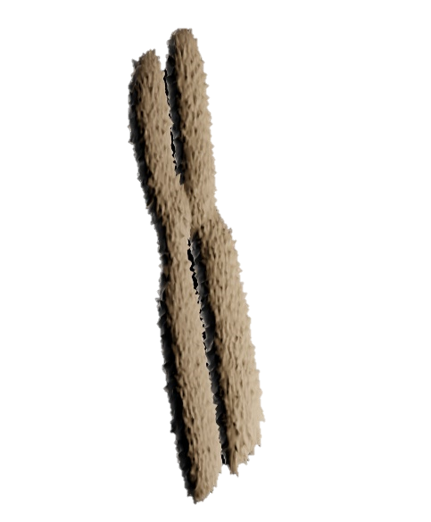

Types of gene mutations
Substitution
Insertion
Deletion
Third secondary year/part I/ Life Sciences - English

Slide 17
1
Duchenne muscular dystrophy (DMD) is a hereditary disease characterized by atrophy and degeneration of muscles. The absence of a protein, dystrophin, which helps build the membrane of muscle fibers, causes this disease. The gene that codes for this protein is located on the X chromosome and has more than 2 million pairs of nucleotides.
1- Pick out from the text the cause of the DMD.
The absence of a protein, dystrophin, which helps build the membrane of muscle fibers, causes DMD disease.
Third secondary year/part I/ Life Sciences - English

Slide 18
Following various mutations, the nucleotide sequence of the gene can change. This can be at the origin of Duchenne myopathy.
Document 1 represents a fragment of the transcribed DNA strand (18 nucleotides) of the normal allele coding for dystrophin protein.
1 9 18
CCA AAC TAA ACC TTA TAT
Document 1
2- Determine, using the genetic code table (Doc 2), the amino acids sequence of the dystrophin encoded by this DNA fragment.
mRNA is complementary to the transcribed DNA strand, A pairs with U, C with G and vice versa and T pairs with A; thus,
mRNA sequence:
GGU UUG AUU UGG AAU AUA
Amino acids sequence:
Gly – Leu – Ile – Trp – Asn - Ile
Document 2
Third secondary year/part I/ Life Sciences - English

Slide 19
Document 1 represents a fragment of the transcribed DNA strand (18 nucleotides) of the normal allele coding for dystrophin protein.
1 9 18
CCA AAC TAA ACC TTA TAT
Document 1
3- Determine the consequences of a mutation at the level of the transcribed DNA strand on the polypeptide formed if:
3.1 The gene has a nucleotide T instead of C in position 12.
If C is replaced by T in position 12, the mRNA sequence becomes: GGU UUG AUU UGA AAU AUA
and the corresponding amino acids sequence will be:
Gly – Leu – Ile
In this case, the amino acids sequence will be shorter (truncated protein) and consequently dystrophin protein is not synthesized.
Document 2
Third secondary year/part I/ Life Sciences - English

Slide 20
Document 1 represents a fragment of the transcribed DNA strand (18 nucleotides) of the normal allele coding for dystrophin protein.
1 9 18
CCA AAC TAA ACC TTA TAT
Document 1
3.2 The gene has a nucleotide T instead of C in position 6.
If C is replaced by T in position 6, the mRNA sequence becomes GGU UUA AUU UGG AAU AUA
and the corresponding amino acids sequence will be:
Gly – Leu – Ile – Trp – Asn – Ile
In this case, the amino acid sequence remains the same; thus, the three dimensional structure of the synthesized protein will remain the same; consequently, its function will not be affected.
Document 2
Third secondary year/part I/ Life Sciences - English

Slide 21
CRDP (2002). Life Science: Secondary Education, Life Sciences. Beirut: CRDP.
https://www.youtube.com/watch?v=a8m66n9oSdk&list=PLvuj2S3rwuvt6AK7feqIW8zgj2n8r8l64
https://www.youtube.com/watch?v=s57DwCQf5tY&list=PLvuj2S3rwuvt6AK7feqIW8zgj2n8r8l64&index=3
https://www.youtube.com/watch?v=foUR_i1pxz4
Third secondary year/part I/ Life Sciences - English

Slide 22
Coordinator: Rana Abdallah
Author: Mohamad Ouaidat
Reviewer: Sahar Ibrahim
Language Editor: Mariam Antar
Translator: Leila Miski

